Slide 1
RSTraders
Details about blockchain

Slide 2
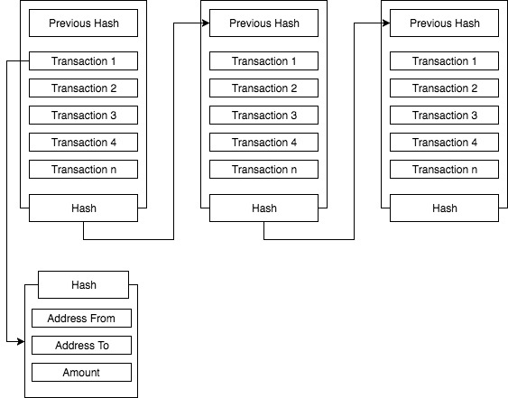
BitCoin BlockChain

Slide 3
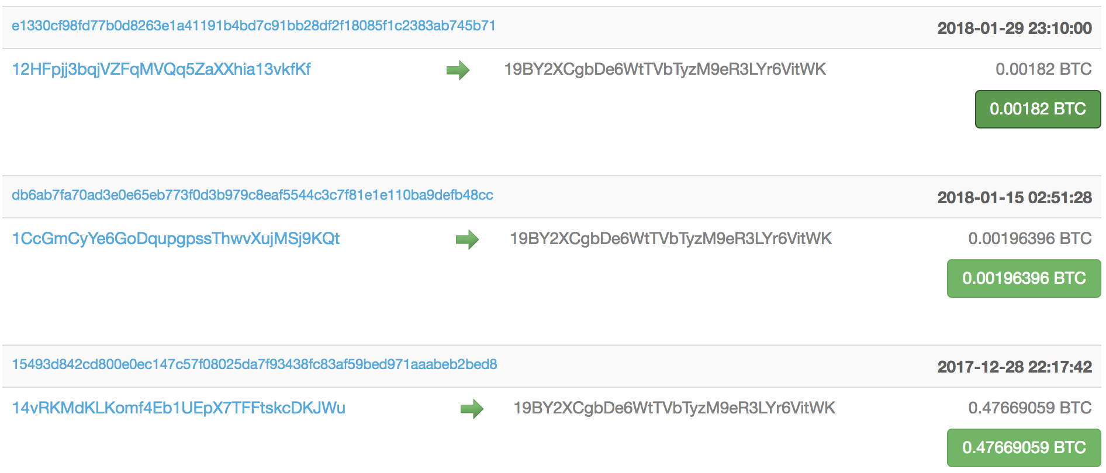
BiTCoin Transactions

Slide 4
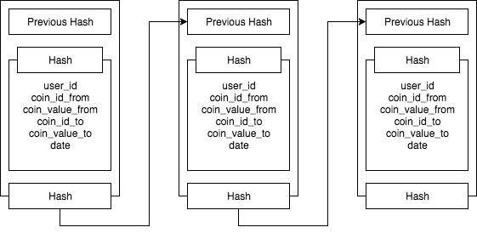
RSTreaders BlockChain

